Slide 1
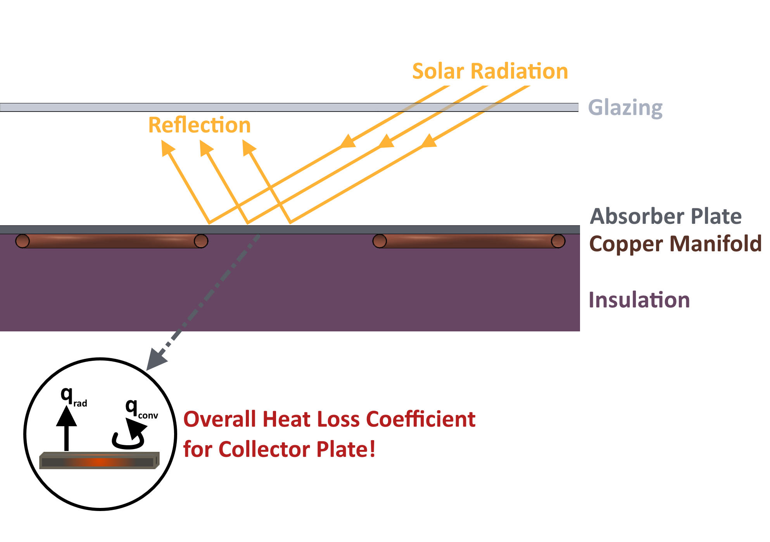
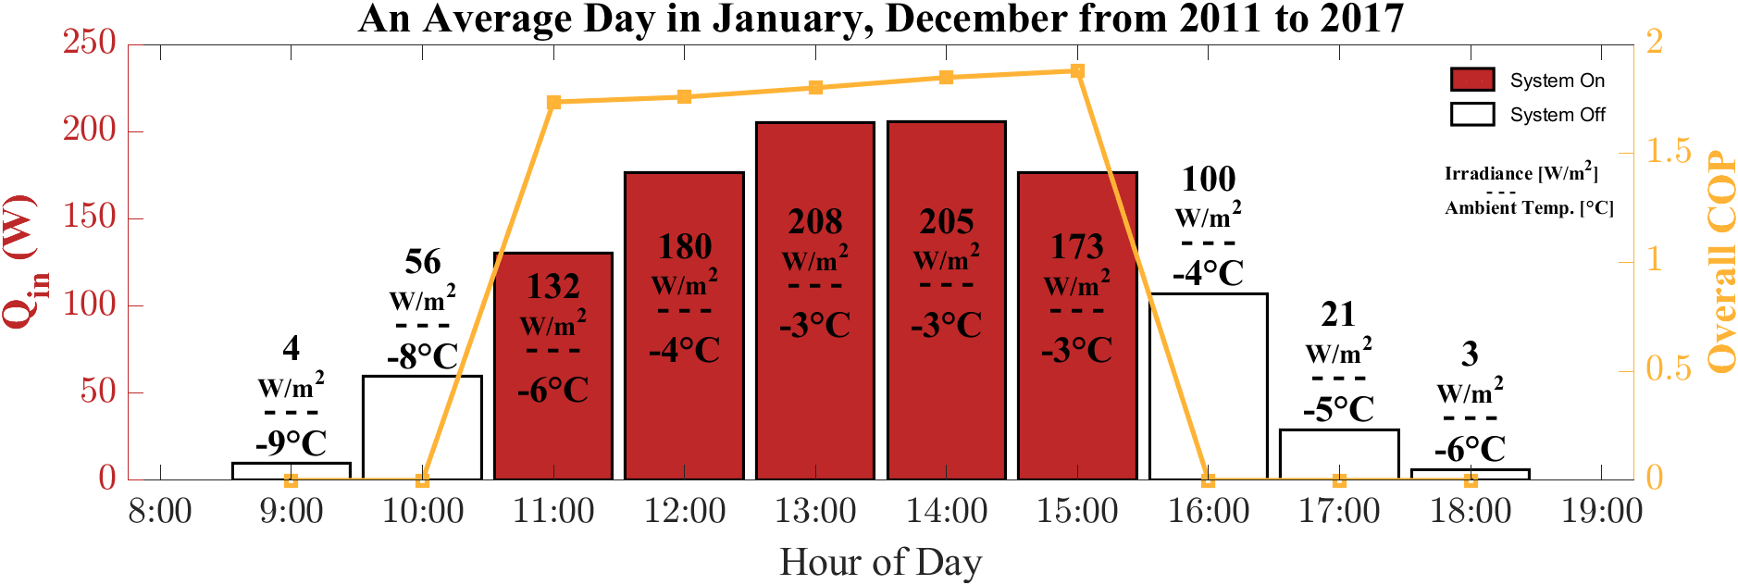
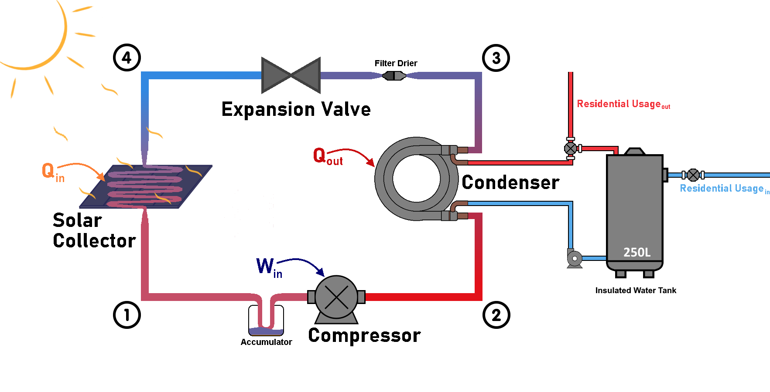
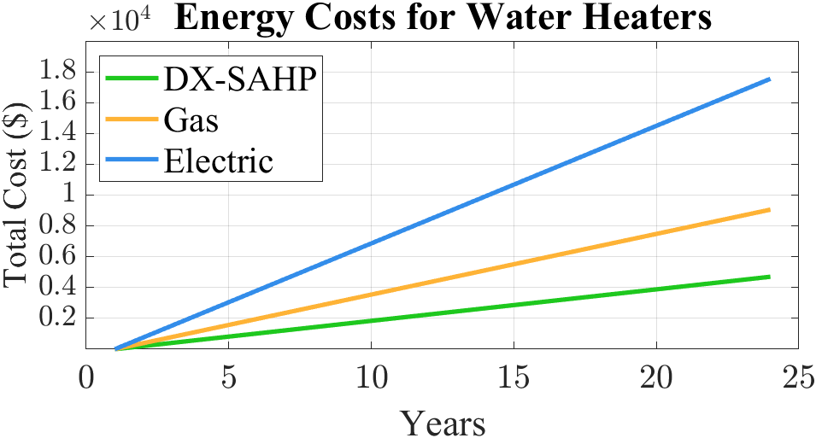


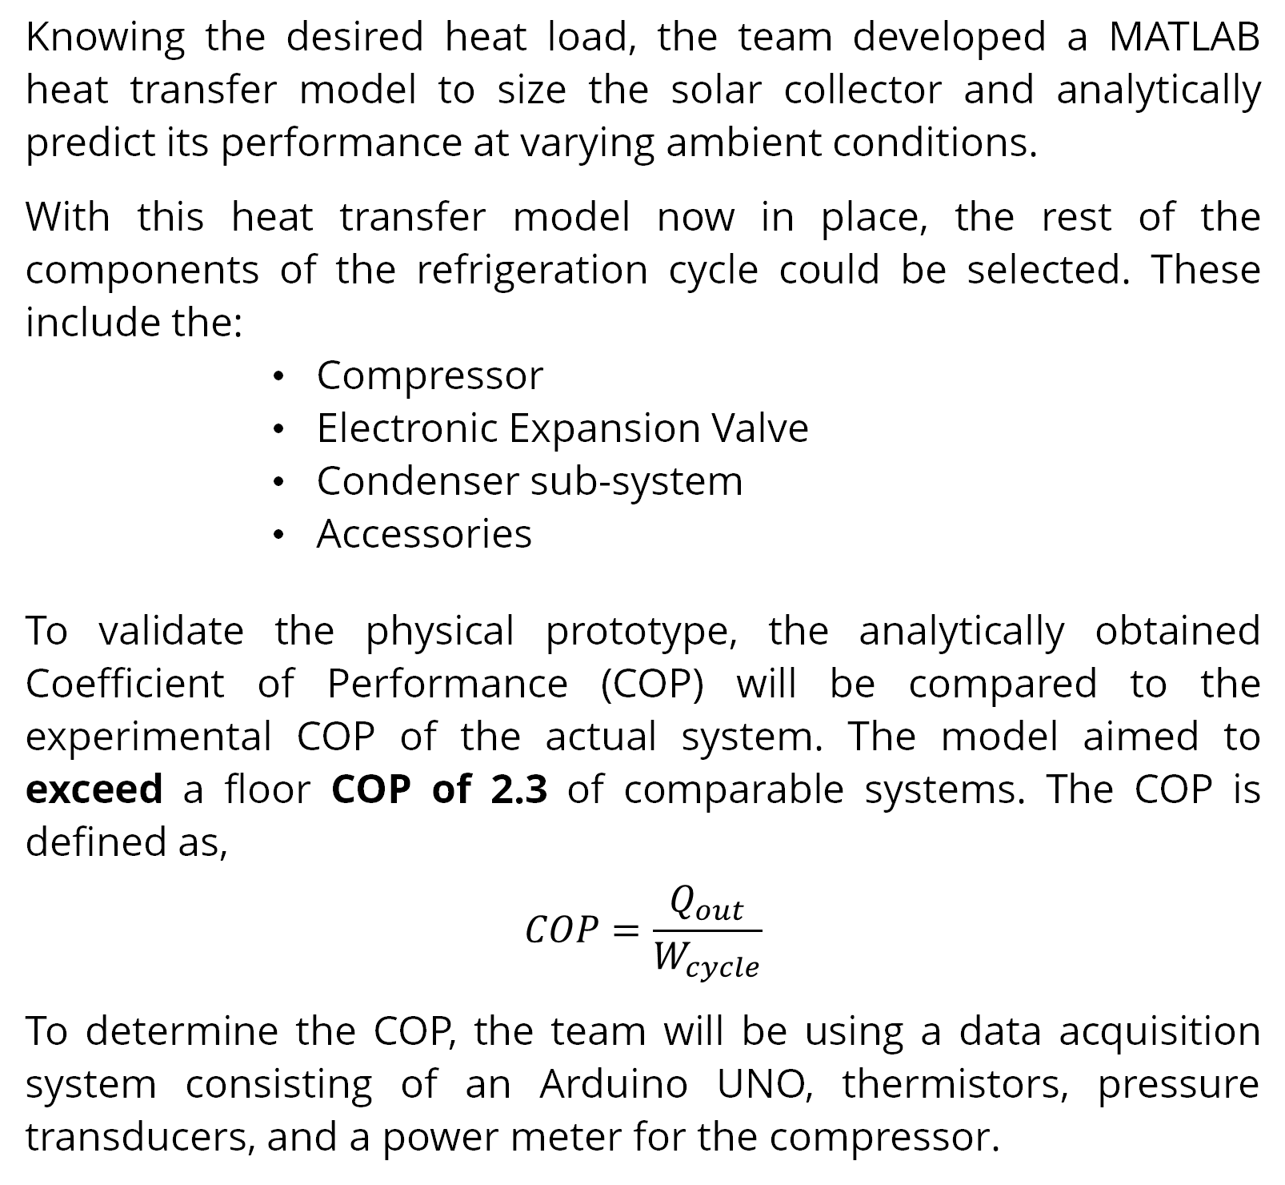
Direct Expansion Solar Assisted Heat Pump (DX-SAHP)
Charuka Marasinghe, Dhruvi Patel, Edwin Pulikkottil, Jessica Sambi, Kerwin Virtusio, Nadia El Gamal
Department of Mechanical & Manufacturing Engineering
University of Calgary
April 2022
Introduction
Discussion & Methodology
The Problem
Solar Thermal Collector
Refrigeration Cycle
Canada consumes approximately 347 PJ of energy for residential and commercial hot water applications on an annual basis. Direct expansion solar assisted heat pump (DX-SAHP) systems have the potential to provide the heat load required for domestic hot water sustainably, potentially saving up to 18 megatons in CO2 emissions. As Calgary has the highest solar potential in Canada, with sunlight available an average of 333 days a year, such a system could provide valuable insight for the future of Calgary as Canada’s energy capital.
The heat transfer model of the solar collector took in several factors such as:
Serpentine tubing material
Absorber plate material
Absorber plate to tubing bonding
Side and bottom insulation thickness
Glazing material
Optimal angle of tilt
Piping diameters
Pitch distances (fin spacing)
Air gap distance
To complete the refrigeration cycle, the compressor and the electronic expansion valve (EEV) compatible with the design constraints and the solar collector were selected on the following criteria:
SCROLL COMPRESSOR
R-134A compatibility
-6ºC to 14ºC evaporation range
0.75hp to 1.25hp power output
EEV
R-134A compatibility
Rated up to 3.7kW capacity
3ºC superheat control
The Solution
Condensing Cycle
The team designed a DX-SAHP system that can operate in colder climates and provide the hot water energy demand for the average Canadian household of 3 people (~2 kW per day).
The DX-SAHP utilizes a solar collector as the evaporator. Inclined at a 51º tilt angle, the absorber plate transfers its heat to a copper manifold underneath it. The R-134A running through the manifold absorbs heat and undergoes evaporation. After flowing through the compressor, the refrigerant then flows to the condenser and exchanges its heat with the water. Leaving the condenser, the refrigerant undergoes expansion, becoming fully liquid at this point. It is now ready to re-enter the collector and the process of heating and cooling repeats! This process is depicted in Figure 3.
Figure 1: Solar Collector Overall Heat Loss Coefficient
The condenser acts as the heat exchanger within the refrigeration cycle; it is a coaxial coil with separate inlet/outlet lines for the refrigerant and water. The refrigerant flows into the condenser and transfers heat to the continuously recirculated water, which is pumped from the insulated tank.
Figure 2 shows the system’s operation during an average day in January and December, two of the coldest months of the year. As the system will require a start-up period for the aluminum plate to absorb heat, irradiance levels lower than 100 W/m² were not considered.
Results
The DX-SAHP is suitable for colder climates. As seen in Figure 2, the simulated results promise that the overall COP of the system will be approximately 2 from 11:00-15:00. The overall COP is the product of the COP of the refrigeration cycle and the solar collector efficiency. In total the system will be able to provide up to 1.1 kW of energy. Along with the compressor, which is rated at a 1 kW capacity, this meets the design goal of 2 kW. This proves that the system runs as expected during optimal hours and may be used during the wintertime to provide domestic hot water reliably.
Methods & Materials
Knowing the desired heat load, the team developed a MATLAB heat transfer model to size the solar collector and analytically predict its performance at varying ambient conditions.
With this heat transfer model now in place, the rest of the components of the refrigeration cycle could be selected. These include the:
Compressor
Electronic Expansion Valve
Condenser sub-system
Accessories
To validate the physical prototype, the analytically obtained Coefficient of Performance (COP) will be compared to the experimental COP of the actual system. The model aimed to exceed a floor COP of 2.3 of comparable systems. The COP is defined as,
$$COP=\frac{Q_{out}}{W_{cycle}}$$
To determine the COP, the team will be using a data acquisition system consisting of an Arduino UNO, thermistors, pressure transducers, and a power meter for the compressor.
Economic & Environmental Analysis
Figure 2: Solar Collector Energy Gain on an Average Winter Day
ECONOMIC
Vs. Electric Water Heater
9-year payback period
Vs. Gas Water Heater
24-year payback period
Total of $62.50 in annual energy savings.
ENVIRONMENTAL
A reduction of 3 tons of GHG emissions annually. This is equivalent to the GHGs emitted by a small vehicle every year.
Sponsors & Special Thanks
Dr. Aggrey Mwesigye, Dr. Simon Li
Figure 3: DX-SAHP Overview
Figure 4: Cost over time of DX-SAHP in comparison to Electric and Natural Gas water heaters
FN INSULATION CALGARY

